Slide 1
“How to map out your FM career and the Future of FM”
John Carrillo, CFM, IFMA Fellow
Director: Planning, Design & Construction
AT&T West Region
1st Vice Chair – IFMA Global Board
Dec. 3, 2018

Slide 2
What is Facility Management?
Facility management is a profession that encompasses multiple disciplines to ensure functionality of the built environment by integrating people, place, process and technology

Slide 3
The State of Modern FM
FM is a US$1.1 trillion global industry
Asia Pacific – US$335.6 billion
North America – US$329.3 billion
Europe – US$264.6 billion
South America – US$22.8 billion
Africa – US$15.3 billion
Middle East – US$12.1 billion
25 million FM practitioners worldwide
Industry has evolved over last 40 years into increasingly strategic discipline
Notes:
Source: Global FM’s “Global Facilities Management Market Sizing Study, 2016.” According to the study, various regions reflect differences in development, sophistication, in-house vs. outsourcing ratio, and overall stage of FM implementation.
The evolution described in the final point was not universal — it was only in certain markets. Now, developing markets appear to be more quickly picking up best practices from the more developed regions.

Slide 6
The Future of FM
Industry unification
Consistency in the practice and standards of FM
FM credentials that demonstrate knowledge and skills
Industry integration
FM joins larger built environment conversation: real estate, design, construction, valuation, etc.
Operational realities no longer an afterthought
Private and Public sector business benefits
- Operational realities no longer an afterthought
- Effective FM solutions, efficiency and savings
- True life cycle planning
- Information age of technology integration
Notes:
Five key advantages of unification:
1) Data Use and Comparison – Right now, building sensors are gathering an incredible amount of data that are simply not useable because there are no standards that allow useful interpretation of the data. A unified FM industry means better utilization of available information, as well as global benchmarking that empowers best practices.
2) Workforce Stability – Finding new FM talent to fill vacancies created by organizational expansion or employee turnover is currently a challenge because there is no single understanding of what an FM ought to be able to do. For hiring managers, a unified FM industry increases the number of qualified applicants because anyone working in the FM field will have a similar skillset.
3) Career Mobility – The corollary to the ability to hire from a larger talent pool is that individual FM professionals will learn skills that are applicable at almost any facility, creating professional mobility. This is a marked improvement from the current realities where isolated and insular protocols used at one company may not translate to useful skills elsewhere, effectively trapping FMs in their current positions.
4) Increased Industry Profile – While the FM industry has begun to get a sense of itself, the outside world remains relatively unaware of the dynamic profession. Industry unification allows FM professionals to effectively march to the same drum, building awareness of their value and role with key influencers across industries and around the world.
5) Empowers Integration – Most aspects of the built environment – construction, real estate, design, etc. – have developed global and regional standards in the hundreds of years they have operated, the FM industry as it currently exists is relatively new to the scene. The lack of FM unity has hobbled the FM industry’s ability to join the bigger built environment conversation. Unity makes it easier to take that critical seat at the built environment table.
Five key advantages of integration:
1) Building systems constructed so they'll actually work – Much attention is paid to smart buildings, green technology and innovative designs. Less attention is currently given to making sure smart buildings operate correctly, green technology is actually working and innovative designs are useable. As a result, the built environment is not used as effectively or efficiently as possible. By including FM input from the very beginning, the chances of implementing building systems that will actually work increases dramatically, leading to lower costs, higher productivity and better overall results.
2) Full life-cycle cost planning – Without needing to consider operation costs, many buildings suffer the results of systems that are cheap to acquire but expensive to operate. Fully 85% of the lifetime cost of a building occurs after construction, yet there is often a disconnect between the design and construction of the buildings and the long-term operation of that building. By integrating FM into the conversation earlier, the full life costs of buildings and their systems can be considered, increasing efficiency and saving money.
3) Seamless transition from construction to operation – It is common for the design/construction team and the FM teams to operate separately. When this happens, there is a period of hand-off where the responsibility for a completed facility is transferred from the former to the latter. In these circumstances, when problems arise, there is frequently a well-choreographed balled of finger-pointing with no clear line of accountability. Each “team” blames the other for problems. An integrated approach creates a chain of accountability, but more importantly it reduces the challenges of the transition from construction to operation.
4) Recognition of FM value – As a relatively new field, FM doesn’t currently enjoy the prestige of more traditional built environment fields, yet the value FM offers touches a huge variety of very topical social issues from sustainability to workplace health and safety to productivity. FM integration demonstrates this value and increases the likelihood that the general public and young people will recognize the incredible career opportunities FM provides.
5) Smart innovation – Innovation within the built environment fields is progressing at a breakneck pace, although currently much of that innovation is hindered by silos. Design and construction innovations are often disconnected from FM innovations, resulting in challenges to fully realizing the benefits. Building design and construction innovations can be more effective if they consider operating requirements and vice versa.
FM as a career choice:
Unification and integration elevate FM in the public mind, making it more likely that top talent will choose a career in FM.

Slide 7
IFMA credentials by the numbers
79% of organizations prefer or require an IFMA credential when hiring, promoting or making salary decisions about FM professionals.
74% of employers feel that the overall reputation of the FM team is improved by having their employees earn an IFMA credential.
70% of employers state that an IFMA credential stimulates strategic thinking.
84% of employers feel that an IFMA credential increases job confidence.
84% of employers state that IFMA credentials increase the collective FM knowledge of their organization.
Notes:
Here’s your opportunity to “sell” the solutions. What you’re really doing is providing evidence that the case study is representative of the entire group. We talked about Melissa Hopkins and Washington University Med School, but similar results are occurring much more broadly.

Slide 9
GWI – Global Workforce Initiative Career Path
FM Certificate (TBD)
High School
X
X
X
Job Opportunities
Management
Facilities Manager
Facilities Professional
Portfolio & Real Estate Professional
Facilities / Property Management Supervisor
Service Technician / Specialist
Community College
X
X
X
X
X
Blue Collar
X
X
X
X
4 year degree
X
X
X
X
Career Transition
X
X
X
Professional Cont.’ Edu.
X
X
X
IFMA 11 Core Competencies Technology
Communications Leadership and Strategy
Emergency Preparedness and Business Continuity Operations and Maintenance
Environmental Stewardship and Sustainability Project Management
Finance and Business Quality
Human Factors Real Estate and Property Management

Slide 11
FM Base (Mean) Salaries $
(Vice President)
$143 190K
$143 190K
5 – Senior Mgr./Director
$116-155K
4 – Manage two or more levels of supervisors
$99-132K
3 – Manage supervisors who manage others
$85-113K
2 - Manage employees (but not supervisors)
$82-107K
1 - Professional Specialist (manage no employees)
Notes: Data Source: Profiles 2011 – IFMA Research Report #35 Salary and Demographics Report. Updated 11/1/2018 (Includes 2% cost of living adjustment per year)
Salaries exclude company benefits and bonuses where applicable. Entry level bonuses can range from 5-12% of salary, mid level bonuses 10-20%, Senior leaders bonuses 20-35% plus stock options and other compensation benefits.
Notes:
Management salary levels are calculated at 2015 salary levels based on a projected cost of living increase data from the Social Security and Telecommunications industry cost of living and wage increases of 3% a year from 2011 to 2015

Slide 12
Fortune 10 FM/CRE Organization Chart
Senior VP
VP – Portfolio, Adm. & Facilities Mgmt.
VP – Design & Construction
VP – Property Mgmt.
AVP – Environmental, Safety & Health
AVP – Energy Mgmt.
Real Estate Transactions
Finance
Portfolio Asset Mgmt.
Strategic Planning
Adm./Systems/Quality/ Training
Supply Chain Contracts
Janitorial Maintenance
Infrastructure Preventative Maintenance
Food Service
Security
Card Access Control
Elevator Maintenance
Fire Suppression Services
Power Broker
Rebate & Incentives Program
Infrastructure Energy Projects
Infrastructure Smart Technology Deployment
Tactical Planning
Project Management
Architectural & Engineering
General & Sub-Contracting
Structural Engineers
Code Compliance Consultants
Fire Life Safety Programs
OSHA Regulations
Municipality, County, State Environmental Compliance
Regulated Waste Programs
Chemical Generator Status Programs
Emergency Preparedness & Business Continuity Programs
Certified Abatement Vendors

Slide 13
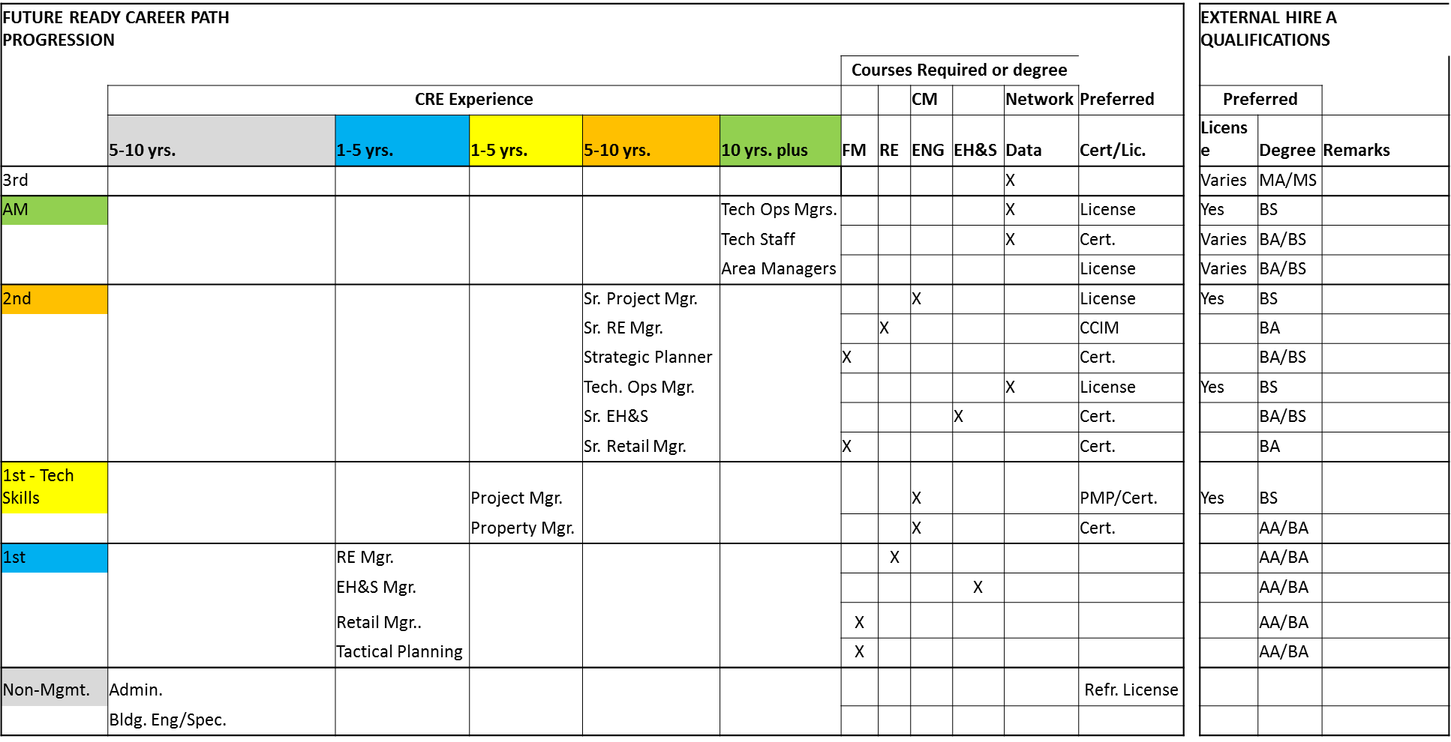
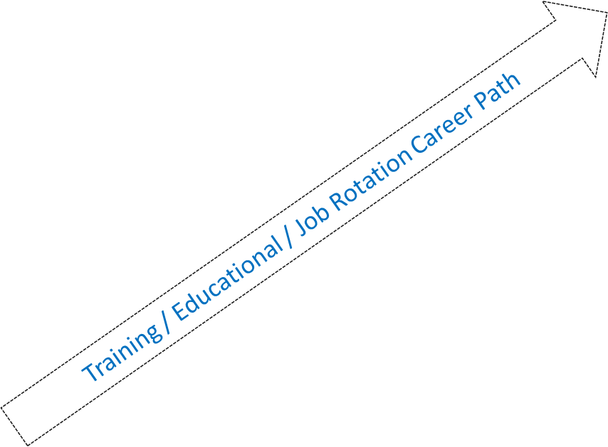
Fortune 10 Company Career Path Progression for Advancement

Slide 14
FM/CRE Career Market
ALL INDUSTRIES WORLDWIDE
 | Government/Regulated | Private
Management Only | Federal/State/Local | Fortune 100 | Large Companies | Small Companies
Org. Structure | Vertical | Vertical | Vertical | Horizontal
Org. Levels | 3 to 5 | 5 to 6 | 4 to 5 | 2 to 3
Employee Base | 25 to 1000 | 1000 to 2000 | 500 to 1000 | 1 to 50
Space | Up to 1B SF | 50M to 500M SF | 10M to 100M | 700K SF per FM
No. of Bldgs. | Up to several thousand | Up to 10's of thousands | Up to 500 | 1 to 100
Supply Chain Bid Process | Limited | Competitive | Competitive | Limited
Travel
International |  | Yes | Yes
National | Yes | Yes | Yes | Yes
Regional | Yes | Yes | Yes | Yes
Outsource Positions | Limited | Varies | Varies | Yes
 | Type of Space - Owned/Leased
 | External Services - Contractors, Vendors, Suppliers, A&E firms, Consultants
 | Alliance Partners/Preferred Vendors
 | Major Service Providers - JLL, C&W, J&J, Sudexo, CBRE, ISS, Others

Slide 15
Leadership Characteristics
> Everyone has the capability to get to the top
Think Future
> Every challenge good or bad, is an opportunity to grow and expand your capabilities
Passion
Emotional Intelligence
> Don’t hurry – small wins are as important as major accomplishments
Clear Expectations
Vision
SELF
Value
> Continually learn, collaborate and innovate
> Always maintain a positive strain and don’t look back
Trust
Global Mindset
Purpose
> Do the right thing – your team and company come first
Engage
Team
> Roll up your sleeves and do the tough jobs – you’ll be noticed
Engage

